Slide 1


Slide 2
UART CONTROLLER STATE MACHINE DESIGN
In this lecture I am going to help guide you in understanding how the UART controller state machine operates. I will also explain the state machine diagram and the signals used to control the state machine.

Slide 3
State Machine
Theory of operation:
The UART Controller state machine is the “main brain” of our UART design. This state machine determines when we are transmitting data, as well as what data we are transmitting. This state machine reads in the data from our UART receiver and stores it in the appropriate registers to be processed.
States we will need:
Initialization State: Wait’s for user input
Transmit Instruction State: Indicate to user design is working correctly
Transmit Error Message State: Indicate wrong command
Receive Command State: Store commands received from UART port
Receive Argument State: Store arguments received from UART port
Execute Command State: Set LEDs or 7 segment

Slide 4
State Machine Diagram
start_controller =‘1’
init_state
transmit_instructions_state
command_complete =‘1’
transmit_complete =‘1’
execute_cmd_state
wait_for_cmd_state
transmit_complete =‘1’
command_received =‘1’
args_received =‘1’
transmit_error_msg_state
wait_for_args_state
invalid_args =‘1’

Slide 5
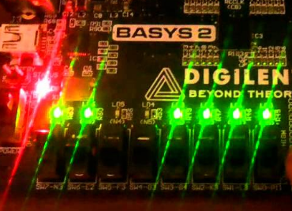
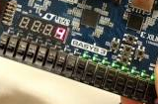

UART Commands
This design will be using only 2 commands, however it will be relatively easy to add support for additional commands.
These commands include
“led”
“7seg”
After we type the command we’ll type a space and then the arguments
The led command accepts 4 arguments, a 4 digit hex value indicating which LED’s are on and off. Which is 0 thru FFFF, all 0’s turns all LED’s off and all F’s turn all LED’s on.

Slide 6
UART Commands
The 7seg command accepts a 4 digit value from 0 to 9,999.
Look on your screen at these example command formats:
7seg 1234 → set’s the value 1234 on the 7 segment display
led FFFF → turns all the LED’s on
This is important to know because we will use this knowledge to transition between states in our state machine.

Slide 7
State Machine Signals
start_controller: Goes high when a button is pressed
transmit_complete: Goes high when all instructions have been transmitted.
command_received: Goes high when we are in the wait_for_cmd_state and we receive a “space”
args_received: Goes high when we are in wait_for_args_state and we receive a “CR” or “LF”
invalid_args: Goes high when we are in execute_cmd_state and our command / arguments doesn’t match
command_complete: Goes high after we set the LED’s 7seg or invalid_args signal

Slide 8
State Machine Advice
1) Look at the source code, it gives you a head start and a structure to follow for the state machine design. Read the comments I have provided
2) Use the diagram shown in this video, which is also located in the PDF included with the source code for this project as reference to help you implement this state machine.
3) Look at each signal evaluated in the state machine and make sure the signal is changing as you would like it to.
4) Use the Vivado simulator, it’s a very powerful tool that can be used to see what’s going on with each of the individual signal as well as forcing signals to verify your state machine is transitioning between states correctly.

Slide 9
UART Controller State Machine
Now that you have an understanding of how the UART controller interacts with the UART, next we will start the actual design.
END

